Slide 1

EVERY DONATION MATTERS

Slide 2
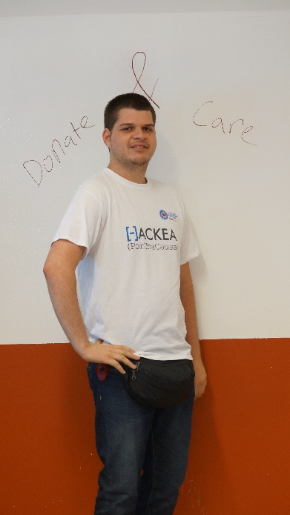
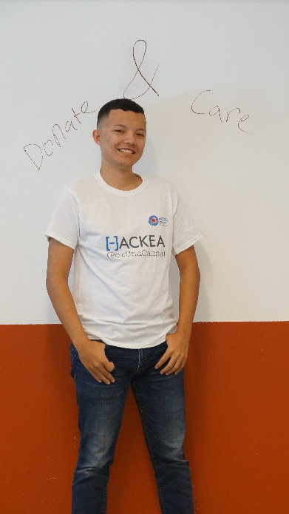
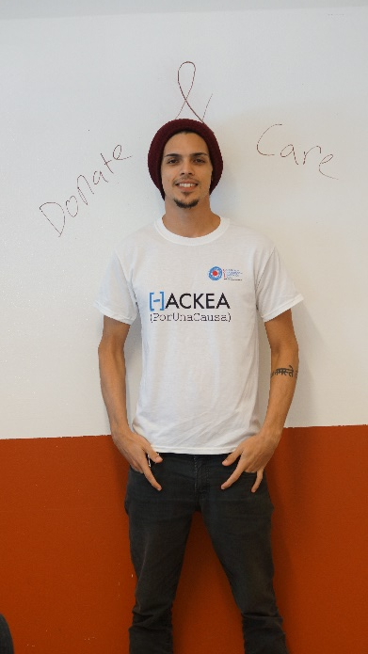
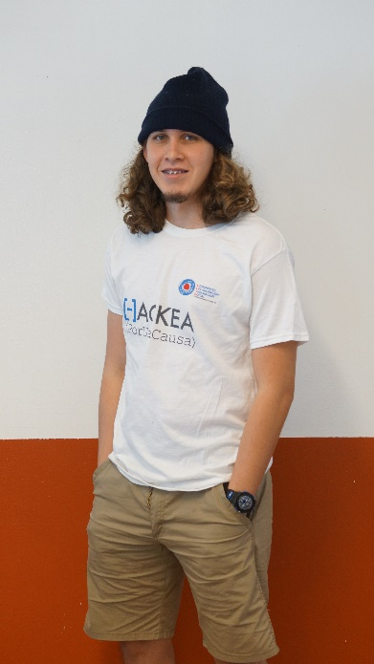
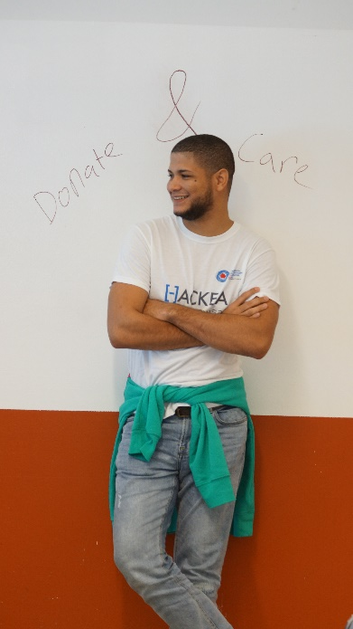
Who we are:
Transaction Specialist
Lead Designers
Lead Designers
Front End Developer
Networking

Slide 3
Problem
81% of nonprofits self report having issues fundraising. Part of this problem involves not being able to track and measure impact to increase donations.

Slide 4
Our webpage provides:
User friendly
Information
User comes first

Slide 5
Live Demo

